Slide 1

멀티미디어
Gi Sook Jung, Ph.D
School of Computer Science and Engineering
College of IT Engineering, KNU

Slide 2
Multimedia
Multi + Medium
  다중 매체: 여러 형식의 정보 콘텐츠
  비디오, 오디오, 이미지, 텍스트, 상호작용 등
  다양한 형태의 정보를 하나의 형식으로 집중하여 표현하는 매체
선형 콘텐츠
  한번 재생되면 사용자의 상호작용 없이도 끝까지 재생되는 콘텐츠
  라디오, 영화, …
비선형 콘텐츠
  사용자와의 상호작용을 통해 흐름을 제할 수 있는 콘텐츠
  프레젠테이션, 게임, …

Slide 3
Multimedia
안드로이드
  소리의 재생 / 녹음
  동영상의 재생
사용 가능한 형식
  오디오 포맷
    WAV, MP3, MIDI, OGG, 3GP
  비디오 포맷
    H.263, H.264, MPEG4
  제조사에서 코덱을 추가하여 더 많은 형식을 지원할 수 있음

Slide 4
Multimedia
종류 | 형식 | 쓰기 | 읽기 | 파일
오디오 | AAC LC/LTP |  | O
 | HE-AACv1 (AAC+) |  | O | 3GPP(.3gp) 및 MPEG-4(.mp4, .m4a)
 | HE-AACv2 |  | O | AAC(.aac) (Raw AAC는 미지원)
 | AMR-NB | O | O | 3GPP(.3gp)
 | AMR-WB |  | O | 3GPP(.3gp)
 | MPEG Audio Layer 3 |  | O | MP3(.mp3)
 | MIDI |  | O | Type 0/1(.mid, .xmf, .mxmf), RTTTL/RTX (.rtttl, .rtx), OTA (.ota), iMelody (.imy)
 | Ogg Vorbis |  | O | Ogg (.ogg)
 | PCM |  | O | WAVE (.wav)
이미지 | JPEG | O | O | JPEG (.jpg)
 | Graphics Interchange Format |  | O | GIF (.gif)
 | Portable Network Graphics |  | O | PNG (.png)
 | Windows Bitmap |  | O | BMP (.bmp)
비디오 | H.263 | O | O | 3GPP (.3gp)
 | H.264 | O | O | 3GPP (.3gp) 및 MPEG-4 (.mp4)
 | MPEG4 SP |  | O | 3GPP (.3gp)

Slide 5
MediaPlayer Class
생성자
  public MediaPlayer ( )
대상지정
  void setDataSource (String path)
  void setDataSource (Context context, Uri uri)
준비
  void prepare ( )
  void prepareAsync ( ): 비동기적으로 동작, 완료시 콜백을 통해 통보
통합된 과정
  static MediaPlayer create (Context context, int resId)
  static MediaPlayer create (Context context, Uri uri, [SurfaceHolder holder])
  파일은 열 수 없음

Slide 6
MediaPlayer Class
재생관련
  void start ( )
  void stop ( )
  void pause ( )
반복
  void setLooping (boolean looping)
  boolean isLooping ( )
정리
  void release ( )
  void reset ( )

Slide 7
MediaPlayer Class
재생 길이 조사, 위치 조사, 변경
  int getDuration ( )
  int getCurrentPosition ( )
  void seekTo (int msec)
상태변경이나 에러 발생에 대한 콜백 메서드
  void setOnErrorListener (MediaPlayer.OnErrorListener listener)
  void setOnPreparedListener (MediaPlayer.OnPreparedListener listener)
  void setOnCompletionListener (MediaPlayer.OnCompletionListener listener)
  void setOnBufferingUpdateListener (MediaPlayer.OnBufferingUpdateListener listener)
  void setOnSeekCompleteListener (MediaPlayer.OnSeekCompleteListener listener)

Slide 8
MediaPlayer
new
reset()
대기
setDataSource()
초기화
오류
prepareAsync()
prepare()
create()
준비
준비중
release()
종료
start()
재생
prepare()
pause()
stop()
prepareAsync()
start()
정지
중단
stop()
start()
stop()
완료

Slide 9
Example #01
Sound

Slide 10
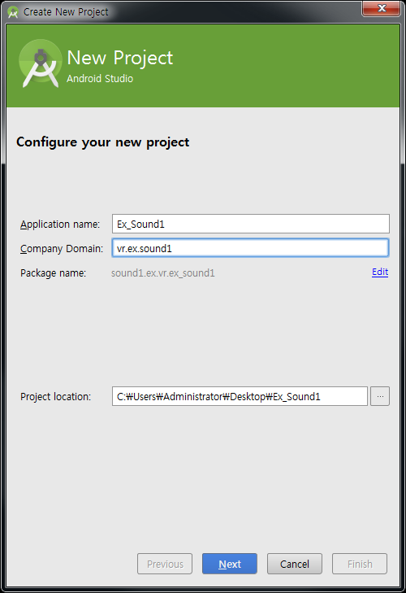
New Project
새로운 프로젝트 시작
  Android Project
  Application name: Ex_Sound1
  Build Target: Android 4.4
  Package name: vr.ex.sound1
  Create Activity: Act1
  Bitbucket/knumobile/lecturenote/downloads/
  각자 원하는 mp3 파일을 이용.
  실습을 위한 mp4 파일 bitbucket 제공.

Slide 11
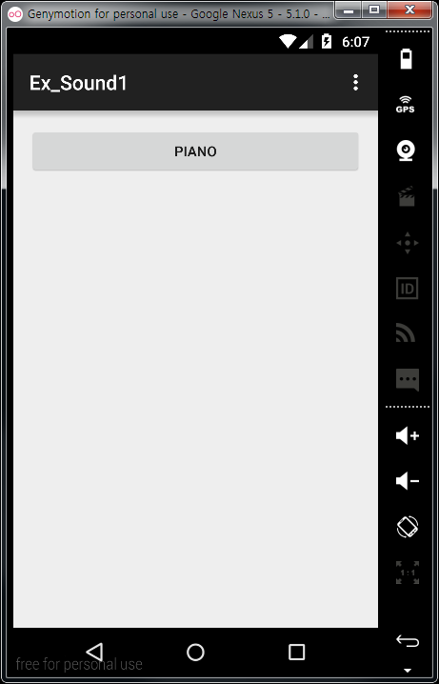
Sound
Ex_Sound1
/res/layout/main.xml
<?xml version="1.0" encoding="utf-8"?>
<LinearLayout xmlns:android="http://sche...
android:orientation="vertical"
android:layout_width="fill_parent"
android:layout_height="fill_parent"
>
<Button
android:id="@+id/button1"
android:text=“Piano"
android:layout_width="match_parent"
android:layout_height="wrap_content"
android:onClick="startMP"
/>
</LinearLayout>

Slide 12
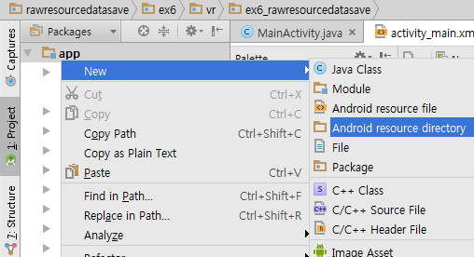
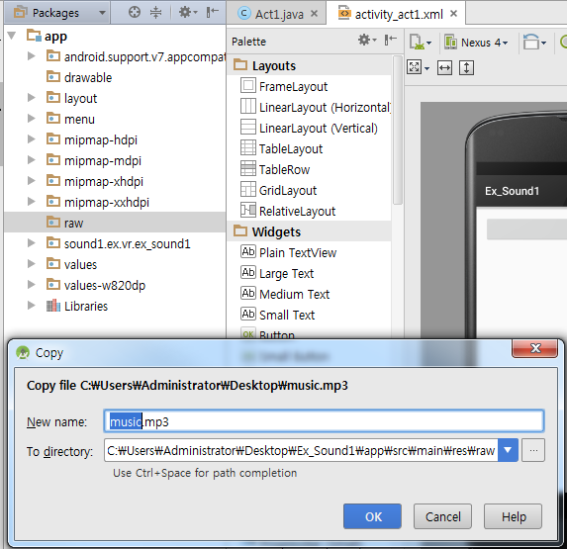
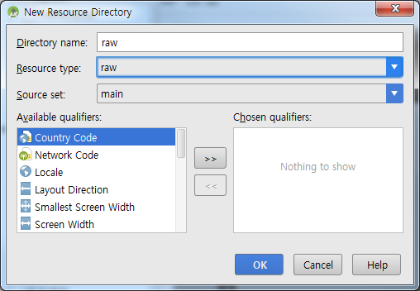
Sound
Raw 리소스에 사운드 파일을 추가
  /res/raw/music.mp3
①
②
③

Slide 13
MediaPlayer
Ex_Sound1
/src/Act1.java
public class Act1 extends Activity {
private MediaPlayer mPlayer = null;
/** Called when the activity is first created. */
@Override
public void onCreate(Bundle savedInstanceState) {
super.onCreate(savedInstanceState);
setContentView(R.layout.main);
mPlayer = MediaPlayer.create(this, R.raw.music);
}
public void startMP(View v) {
mPlayer.start();
}
}

Slide 14
Example #02
Audio

Slide 15
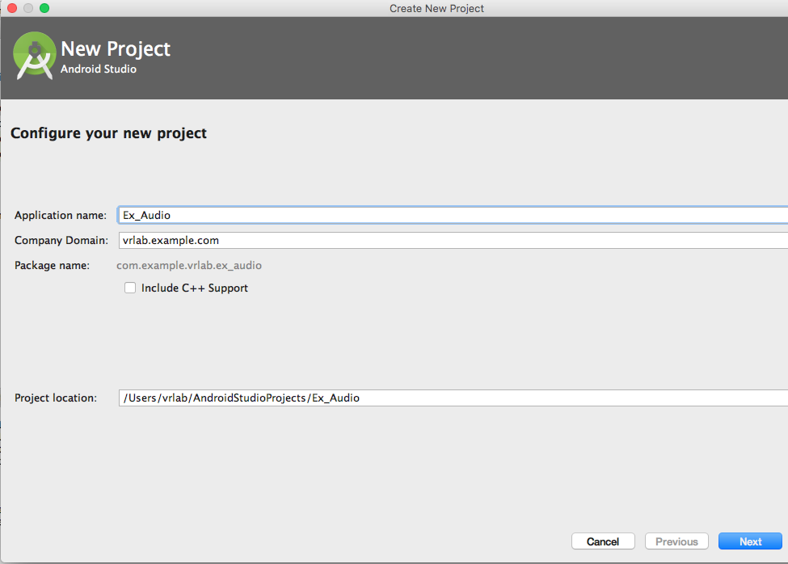
New Project
새로운 프로젝트 시작
  Android Project
  Project name: Ex_Audio
  Build Target: Android 4.4
  Package name: vr.ex.Audio
  Create Activity: Act1
  Ex1과 동일하게 raw에 music.mp3 추가

Slide 16
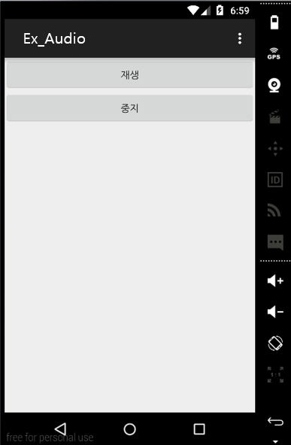
Audio
Ex_Audio
/res/layout/main.xml
<Button
android:id="@+id/button1"
android:text="재생"
android:layout_width="match_parent"
android:layout_height="wrap_content"
android:onClick="startMP"
/>
<Button
android:id="@+id/button2"
android:text="중지"
android:layout_width="match_parent"
android:layout_height="wrap_content"
android:onClick="stopMP"
/>

Slide 17
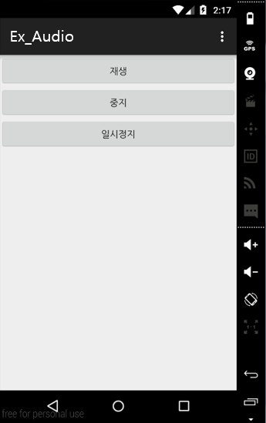
MediaPlayer
Ex_Audio
/res/layout/main.xml
<Button
android:id="@+id/button1"
android:text="재생"
android:layout_width="match_parent"
android:layout_height="wrap_content"
android:onClick="startMP"
/>
<Button
android:id="@+id/button2"
android:text="중지"
android:layout_width="match_parent"
android:layout_height="wrap_content"
android:onClick="stopMP"
/>
<Button
android:id="@+id/button3"
android:text="일시정지"
android:layout_width="match_parent"
android:layout_height="wrap_content"
android:onClick="pauseMP"
/>

Slide 18
MediaPlayer
Ex_Audio
/src/Act1.java
public class Act1 extends Activity {
private MediaPlayer mPlayer = null;
/** Called when the activity is first created. */
@Override
public void onCreate(Bundle savedInstanceState) {
super.onCreate(savedInstanceState);
setContentView(R.layout.main);
initMP();
}
@Override
protected void onDestroy() {
if (mPlayer != null) {
mPlayer.release();
mPlayer = null;
}
super.onDestroy();
}

Slide 19
MediaPlayer
Ex_Audio
/src/Act1.java
public void initMP() {
mPlayer = MediaPlayer.create(this, R.raw.music);
}
public void startMP(View v) {
mPlayer.start();
mPlayer.setLooping(true);
}
}
생성
재생
반복재생 설정

Slide 20
MediaPlayer
Ex_Audio
/src/Act1.java
public void pauseMP(View v) {
if (mPlayer.isPlaying()) {
mPlayer.pause();
} else {
mPlayer.start();
}
}
public void stopMP(View v) {
mPlayer.stop();
initMP();
}

Slide 21
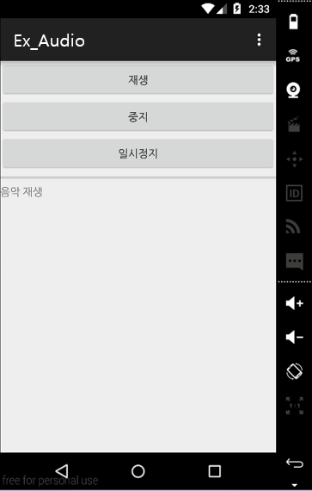
진행률 막대
Ex_Audio
/res/layout/main.xml
<Button
android:id="@+id/button3"
android:text="일시정지"
android:layout_width="match_parent"
android:layout_height="wrap_content"
android:onClick="pauseMP"
/>
<ProgressBar
android:id="@+id/progressBar1"
android:layout_width="match_parent"
android:layout_height="wrap_content"
style="?android:attr/progressBarStyleHorizontal"
/>
<TextView
android:id="@+id/textView1"
android:text="음악 재생"
android:layout_width="match_parent"
android:layout_height="wrap_content"
/>

Slide 22
MediaPlayer
Ex_Audio
/src/Act1.java
public class Act1 extends Activity implements Runnable {
private MediaPlayer mPlayer = null;
private ProgressBar mProgress;
…
public void showProgress() {
if (mPlayer != null && mPlayer.isPlaying()) {
mProgress.setProgress(mPlayer.getCurrentPosition());
TextView output = (TextView)findViewById(R.id.textView1);
output.setText(
"재생 중"
+ "\n현재 위치: " + mPlayer.getCurrentPosition() / 1000
+ "\n전체 길이: " + mPlayer.getDuration() / 1000 );
}
}

Slide 23
MediaPlayer
Ex_Audio
/src/Act1.java
Class ProThread extends Thread{
public Handler mHandler = new Handler() {
public void handleMessage(Message msg) {
if (msg.what == 1) {
showProgress();
}
}
};
public void run() {
while (mPlayer != null) {
try {
Thread.sleep(500);
} catch (InterruptedException e) {
e.printStackTrace();
break;
}
mHandler.sendMessage(Message.obtain(mHandler, 1));
}
}
}
쓰레드와 핸들러를 활용하여 화면을 갱신

Slide 24
MediaPlayer
Ex_Audio
/src/Act1.java
public void initMP() {
mPlayer = MediaPlayer.create(this, R.raw.music);
mProgress = (ProgressBar)findViewById(R.id.progressBar1);
mProgress.setProgress(0);
mProgress.setMax(0);
ProThread thrd = new new ProThread();
thrd.setDaemon(true);
thrd.start();
}

Slide 25
MediaPlayer
Ex_Audio
/src/Act1.java
public void startMP(View v) {
Button btn;
btn = (Button)findViewById(R.id.button1); // 각 버튼의 상황별 Enable 결정
btn.setEnabled(false);
btn = (Button)findViewById(R.id.button2);
btn.setEnabled(true);
mProgress.setProgress(0);
mProgress.setMax(mPlayer.getDuration());
mPlayer.setLooping(true);
mPlayer.start();
}

Slide 26
MediaPlayer
Ex_Audio
/src/Act1.java
public void pauseMP(View v) {
if (mPlayer.isPlaying()) {
mPlayer.pause();
TextView output = (TextView)findViewById(R.id.textView1);
output.setText("일시정지");
} else {
mPlayer.start();
}
}
public void stopMP(View v) {
mPlayer.stop();
initMP();
Button btn;
btn = (Button)findViewById(R.id.button1);
btn.setEnabled(true);
btn = (Button)findViewById(R.id.button2);
btn.setEnabled(false);
mProgress.setProgress(0);
mProgress.setMax(0);
TextView output = (TextView)findViewById(R.id.textView1);
output.setText("중지");
}
}

Slide 27
Example #03
Video

Slide 28
SurfaceView
Surface
  SurfaceView는 SurfaceView 자체가 내용을 표시하는 것이 아니라 내부의 SurfaceHolder를 통해 최종적으로 Surface라는 객체 위에 그 내용을 표시
SurfaceView
Surface
SurfaceHolder
Image or Video
Notes:
http://mobileandlife.tistory.com/268
SurfaceView 란 말그대로 일종의 View
TextView 나 ImageView 와 달리 직접 View에 컨텐츠를 표시하지 않음
SurfaceView 는 뷰 계층구조 내에서 드로잉 전용 공간 surface를 제공하는 뷰에 대한 특수한 서브클래스
일반적인 View 는 화면에 뷰를 표시하는 연산과 기타 연산, 사용자와의 상호작용 처리 등이 모두 하나의 쓰레드에서 되지만,
이러한 뷰를 실시간으로 화면을 받아와야하는 카메라 뷰로 사용한다면 다른 작업을 아무것도 할 수 없음.
따라서 카메라 뷰는 화면 업데이트를 백그라운드 쓰레드로 수행하여 어플리케이션 자원을 잠식하지 않는 SurfaceView로 사용함

Slide 29
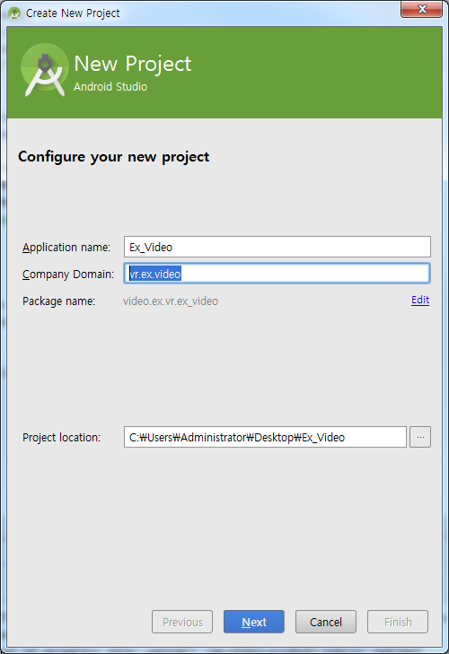
New Project
새로운 프로젝트 시작
  Android Project
  Application name: Ex_Video
  Build Target: Android 4.4
  Package name: vr.ex.video
  Create Activity: Act1

Slide 30
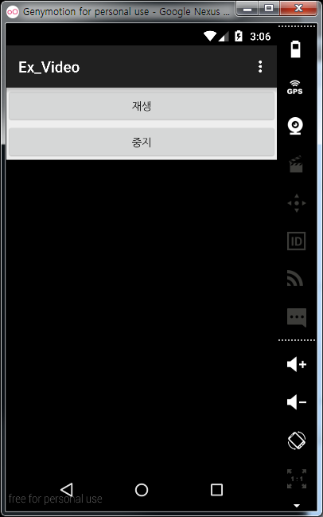
Video
Ex_Video
/res/layout/main.xml
<Button
android:id="@+id/button1"
android:text="재생"
android:layout_width="match_parent"
android:layout_height="wrap_content"
android:onClick="startMP"
/>
<Button
android:id="@+id/button2"
android:text="중지"
android:layout_width="match_parent"
android:layout_height="wrap_content"
android:onClick="stopMP"
/>
<SurfaceView
android:id="@+id/surfaceView1"
android:layout_width="match_parent"
android:layout_height="match_parent"
/>

Slide 31
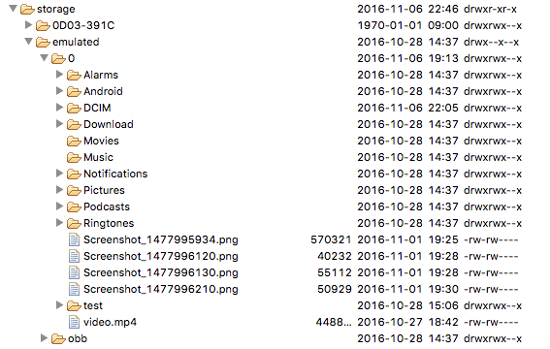
Video
SD카드에 영상 파일을 추가
  DDMS에서 기기로 Push
  API 23이하 버전을 이용 (api24 DDMS 미작동)
  Manifest에 permission 추가
<uses-permission android:name="android.permission.READ_EXTERNAL_STORAGE" />

Slide 32
Video
Ex_Video
/src/Act1.java
public class Act1 extends Activity {
private MediaPlayer mPlayer = null;
private SurfaceView mView;
private SurfaceHolder mHolder;
private String mSdPath = Environment.getExternalStorageDirectory()
.getAbsolutePath();
private String mVideoFile = "test.mp4";
/** Called when the activity is first created. */
@Override
public void onCreate(Bundle savedInstanceState) {
super.onCreate(savedInstanceState);
setContentView(R.layout.activity_act1);
mView = (SurfaceView) findViewById(R.id.surfaceView1);
mHolder = mView.getHolder();
mHolder.setType(SurfaceHolder.SURFACE_TYPE_PUSH_BUFFERS);
mPlayer = new MediaPlayer();
//mPlayer.setDisplay(mHolder);
}

Slide 33
Video
Ex_Video
/src/Act1.java
protected void onDestroy() {
if (mPlayer != null) {
mPlayer.release();
mPlayer = null;
}
super.onDestroy();
}
public void startMP(View v) {
try {
mPlayer.setDataSource(mSdPath + "/" + mVideoFile);
mPlayer.setDisplay(mHolder);
mPlayer.prepare();
} catch (IOException e) {
e.printStackTrace();
return;
}
mPlayer.setLooping(true);
mPlayer.start();
}
public void stopMP(View v) {
mPlayer.stop();
mPlayer.reset();
}
}

Slide 34
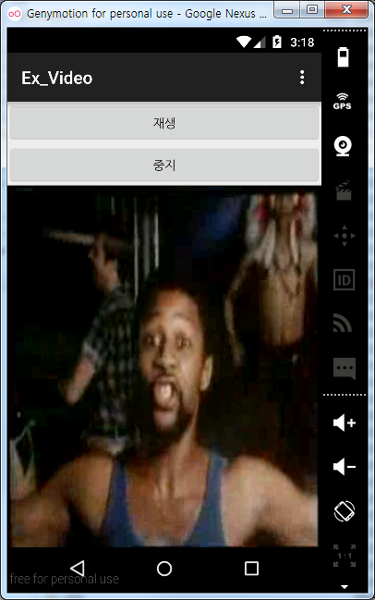
Video
Device에서 실행된 화면

Slide 35
VideoView Class
대상지정
  void setVideoPath (String path)
  void setVideoURI (Uri uri)
재생 및 중지
  void start ( )
  void stopPlayback ( )
  void pause ( )
  void seekTo (int msec)
MediaController Class
  동영상 재생관련 버튼과 재생 위치를 나타내는 프로그래스바 제공
  new 연산자로 생성하여 VideoView에 부착
  void setMediaController (MediaController controller)

Slide 36
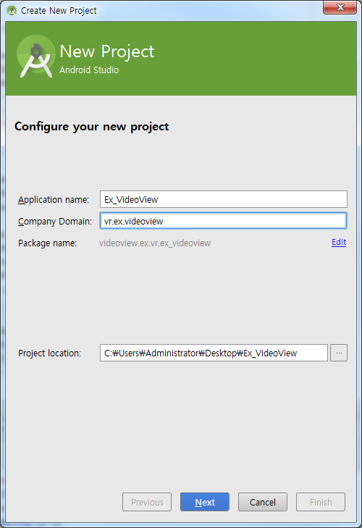
New Project
새로운 프로젝트 시작
  Android Project
  Application name: Ex_VideoView
  Build Target: Android 4.4
  Package name: vr.ex.videoview
  Create Activity: Act1

Slide 37
VideoView
Ex_Videoview
/res/layout/main.xml
<LinearLayout
android:orientation="vertical"
android:layout_width="match_parent"
android:layout_height="match_parent"
xmlns:android="http://schemas.android.com/apk/res/android">
<VideoView
android:id="@+id/surface_view"
android:layout_width="320px"
android:layout_height="240px" />
</LinearLayout>

Slide 38
VideoView
Ex_Videoview
/src/Act1.java
public class Act1 extends Activity {
private VideoView mVideoView;
private String mSdPath = Environment.getExternalStorageDirectory()
.getAbsolutePath();
private String mVideoFile = “video.mp4";
private String path = mSdPath + "/" + mVideoFile;
/** Called when the activity is first created. */
@Override
public void onCreate(Bundle savedInstanceState) {
super.onCreate(savedInstanceState);
setContentView(R.layout.activity_act1);
mVideoView = (VideoView) findViewById(R.id.surface_view);
MediaController mediaController = new MediaController(this);
mediaController.setAnchorView(mVideoView);
동영상 재생에 특화된 위젯
MediaController import 시 android.widget.VideoView 로 할 것

Slide 39
VideoView
Ex_Videoview
/src/Act1.java
Manifest에 permission 추가
Log.d("4csoft", "---- path : " + path);
if (path == "") {
Toast.makeText(
Act1.this,
"Please edit VideoViewDemo Activity, and set path"
+ " variable to your media file URL/path",
Toast.LENGTH_LONG).show();
} else {
mVideoView.setMediaController(mediaController);
mVideoView.setVideoPath(path);
mVideoView.start();
}
}
<uses-permission android:name="android.permission.READ_EXTERNAL_STORAGE" />

Slide 40
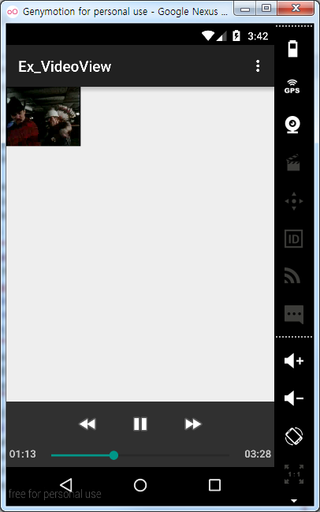
VideoView

Slide 41
Example #04
Permission

Slide 42
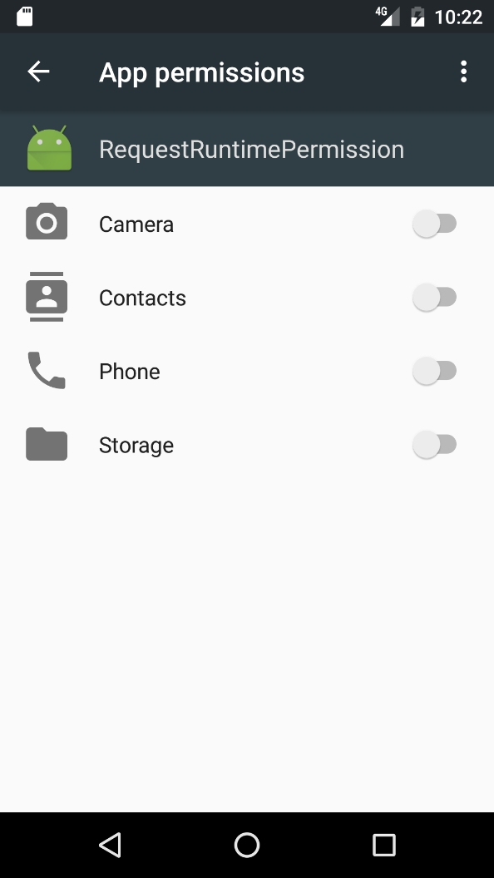
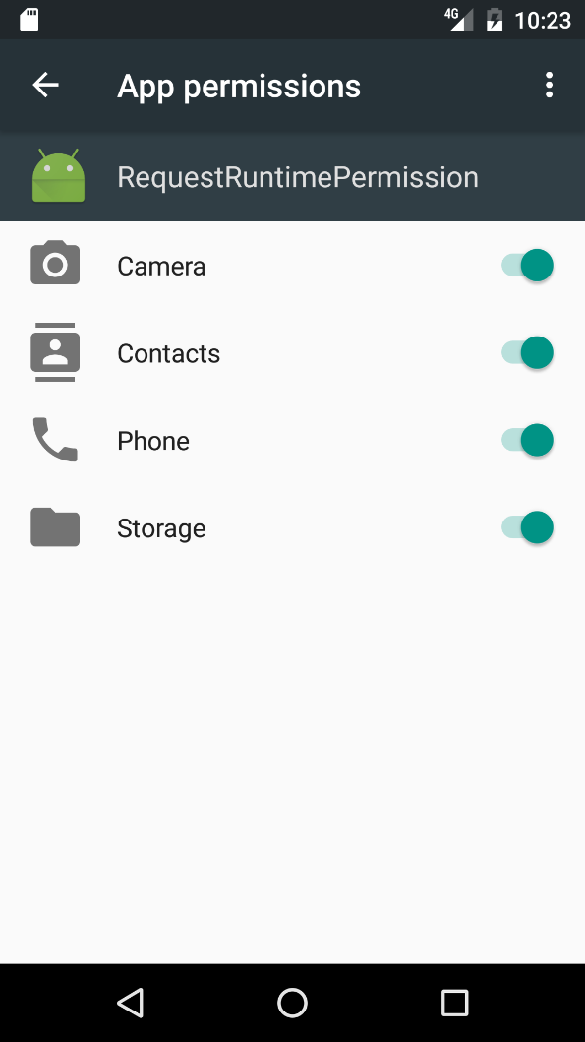
Permission
Permission 설정
  API 23이상 버전을 이용 시

Slide 43
Permission
RequestRuntimePermission
/res/layout/activitymain.xml
<Button
android:layout_width="match_parent"
android:layout_height="wrap_content"
android:text="Call"
android:id="@+id/call"
android:onClick="ask"
android:layout_marginBottom="10dp”/>
<Button
android:layout_width="match_parent"
android:layout_height="wrap_content"
android:text="Read ExStorage"
android:id="@+id/read"
android:onClick="ask"
android:layout_marginBottom="10dp”/>
<Button
android:layout_width="match_parent"
android:layout_height="wrap_content"
android:text="Camera"
android:id="@+id/camera"
android:onClick="ask"
android:layout_marginBottom="10dp"/>
<Button
android:layout_width="match_parent"
android:layout_height="wrap_content"
android:text="Get Accounts"
android:id="@+id/accounts"
android:onClick="ask"
android:layout_marginBottom="10dp"/>

Slide 44
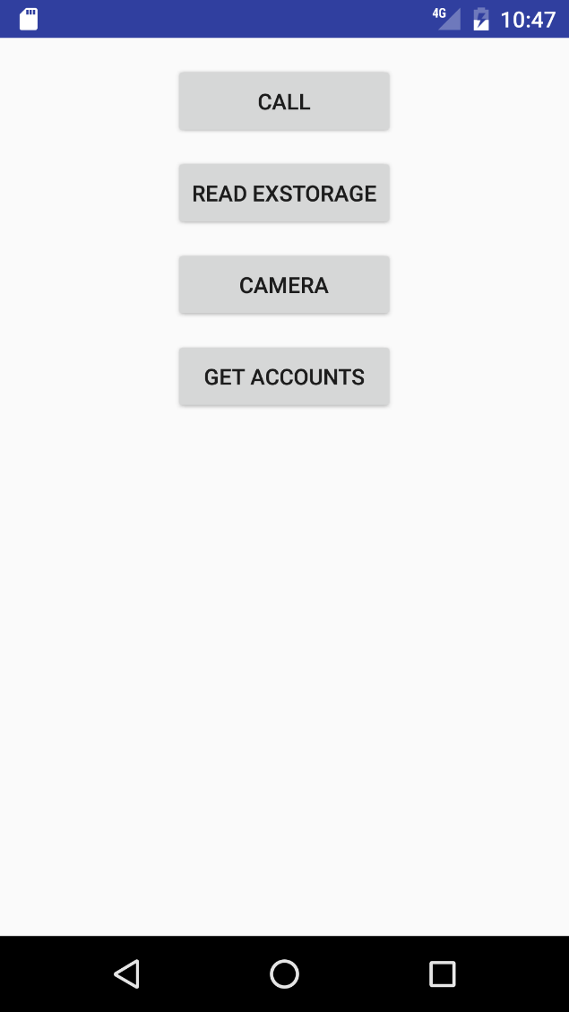
Permission

Slide 45

Permission
RequestRuntimePermission
/manifests/AndroidManifest.xml
<?xml version="1.0" encoding="utf-8"?>
<manifest xmlns:android="http://schemas.android.com/apk/res/android"
package="com.example.vrlab.requestruntimepermission">
<uses-permission android:name="android.permission.CALL_PHONE"/>
<uses-permission android:name="android.permission.READ_EXTERNAL_STORAGE"/>
<uses-permission android:name="android.permission.CAMERA"/>
<uses-permission android:name="android.permission.GET_ACCOUNTS" />
<application
android:allowBackup="true"
android:icon="@mipmap/ic_launcher"
android:label="@string/app_name"
android:supportsRtl="true"
android:theme="@style/AppTheme">
<activity android:name=".MainActivity">
<intent-filter>
<action android:name="android.intent.action.MAIN" />
<category android:name="android.intent.category.LAUNCHER" />
</intent-filter>
</activity>
</application>
</manifest>

Slide 46
Permission
RequestRuntimePermission
/java/MainActivity.java
public class MainActivity extends Activity {
static final Integer CALL = 1;
static final Integer READ_EXST = 2;
static final Integer CAM = 3;
static final Integer ACCOUNTS = 4;
private void askForPermission(String permission, Integer requestCode)
{
if(ContextCompat.checkSelfPermission(MainActivity.this, permission)
!= PackageManager.PERMISSION_GRANTED) {
if (ActivityCompat.shouldShowRequestPermissionRationale(MainActivity.this, permission)) {
ActivityCompat.requestPermissions(MainActivity.this, new String[]{permission}, requestCode);
} else {
ActivityCompat.requestPermissions(MainActivity.this, new String[]{permission}, requestCode);
}
} else {
Toast.makeText(this, "" + permission + " is already granted", Toast.LENGTH_SHORT).show();
}
}

Slide 47
Permission
RequestRuntimePermission
/java/MainActivity.java
public void ask(View v) {
switch (v.getId()) {
case R.id.call:
askForPermission(Manifest.permission.CALL_PHONE, CALL);
break;
case R.id.read:
askForPermission(Manifest.permission.READ_EXTERNAL_STORAGE, READ_EXST);
break;
case R.id.camera:
askForPermission(Manifest.permission.CAMERA, CAM);
break;
case R.id.accounts:
askForPermission(Manifest.permission.GET_ACCOUNTS, ACCOUNTS);
break;
default:
break;
}
}

Slide 48
Permission
RequestRuntimePermission
/java/MainActivity.java
@Override
public void onRequestPermissionsResult(int requestCode, String permissions[], int[] grantResults) {
super.onRequestPermissionsResult(requestCode, permissions, grantResults);
if(ActivityCompat.checkSelfPermission(this, permissions[0]) == PackageManager.PERMISSION_GRANTED) {
switch (requestCode) {
case 1: // Call
Intent callIntent = new Intent(Intent.ACTION_CALL);
callIntent.setData(Uri.parse("tel:" + "{This is a telephone number}"));
if (ActivityCompat.checkSelfPermission(this, Manifest.permission.CALL_PHONE) != PackageManager.PERMISSION_GRANTED) {
startActivity(callIntent);
}
break;
case 2: // Read EX ST
Intent imageIntent = new Intent(Intent.ACTION_PICK, MediaStore.Images.Media.EXTERNAL_CONTENT_URI);
startActivityForResult(imageIntent, 2);
break;
case 3: // Camera
Intent takePictureIntent = new Intent(MediaStore.ACTION_IMAGE_CAPTURE);
if(takePictureIntent.resolveActivity(getPackageManager()) != null) {
startActivityForResult(takePictureIntent, 3);
}
break;

Slide 49
Permission
RequestRuntimePermission
/java/MainActivity.java
case 4: // Accounts
AccountManager manager = (AccountManager) getSystemService(ACCOUNT_SERVICE);
Account[] list = manager.getAccounts();
Toast.makeText(this, "" +list[0].name, Toast.LENGTH_SHORT).show();
for(int i=0; i<list.length;i++) {
Log.e("Account "+i, ""+list[i].name);
}
}
Toast.makeText(this, "Permission granted", Toast.LENGTH_SHORT).show();
} else {
Toast.makeText(this, "Permission denied", Toast.LENGTH_SHORT).show();
}
}

Slide 50
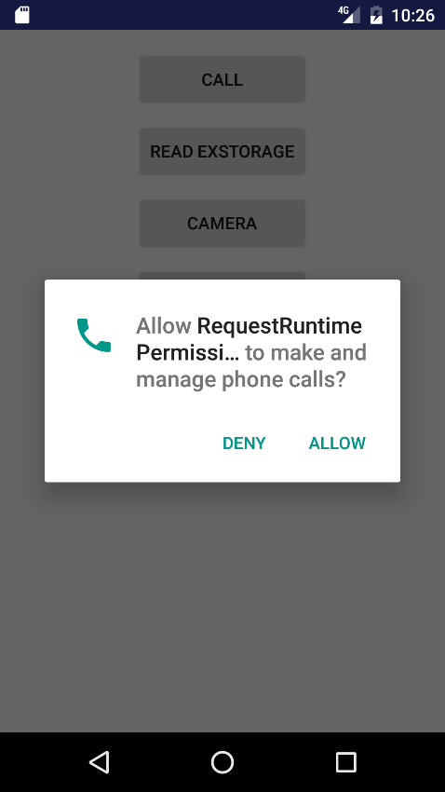
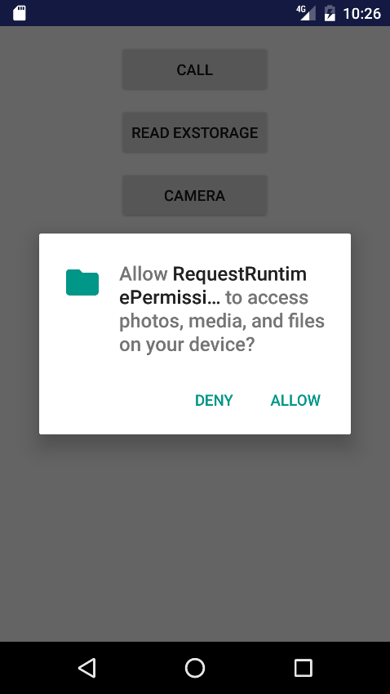
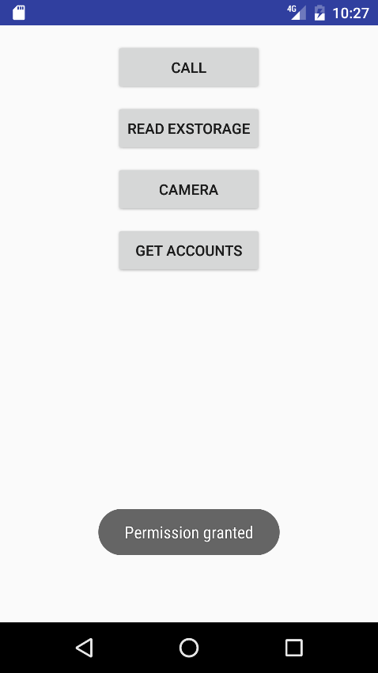
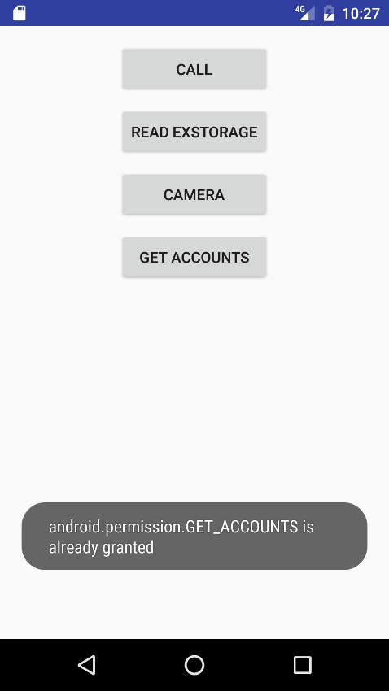
Permission
선택 시
Permission 승인
이미 승인된
Permission을 다시
선택 시

Slide 51
Permission
모두 Allow 했을 시

Slide 52


